Slide 1



Gene-based pan-genome analysis of cucumber
Rocky Shao
2024/08/02

Slide 2



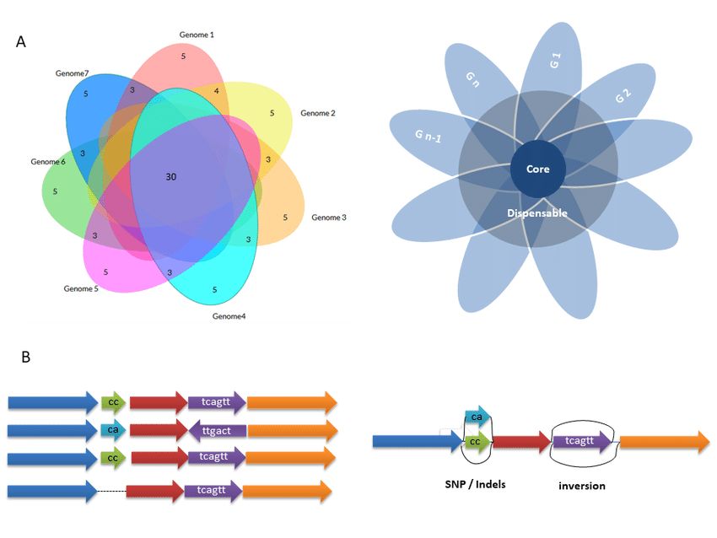
Background
Global challenges
Need more robust crop varieties
Google
Google
Technology advances
Easier to generate pangenomes
Help identify candidate genes for beneficial traits
Google
Google
Notes:
Advances in DNA sequencing technologies made it easier to generate pangenomes from representative individuals of target species. Pangenomic studies have also helped identifying beneficial traits and provided insight into breeding efforts to develop more robust crop varieties These studies have demonstrated success in recent plant research, uncovering evolution and diversity of different plant species and identifying deleterious mutations to facilitate breeding .

Slide 3
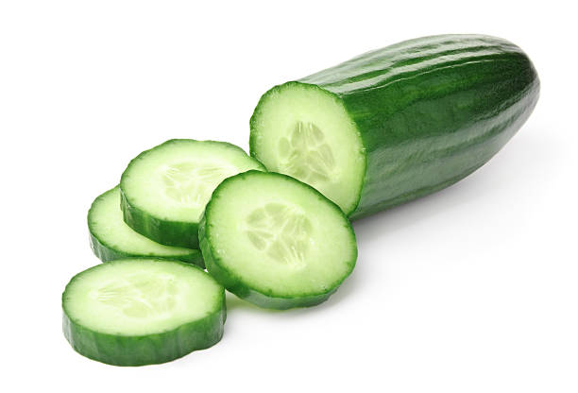
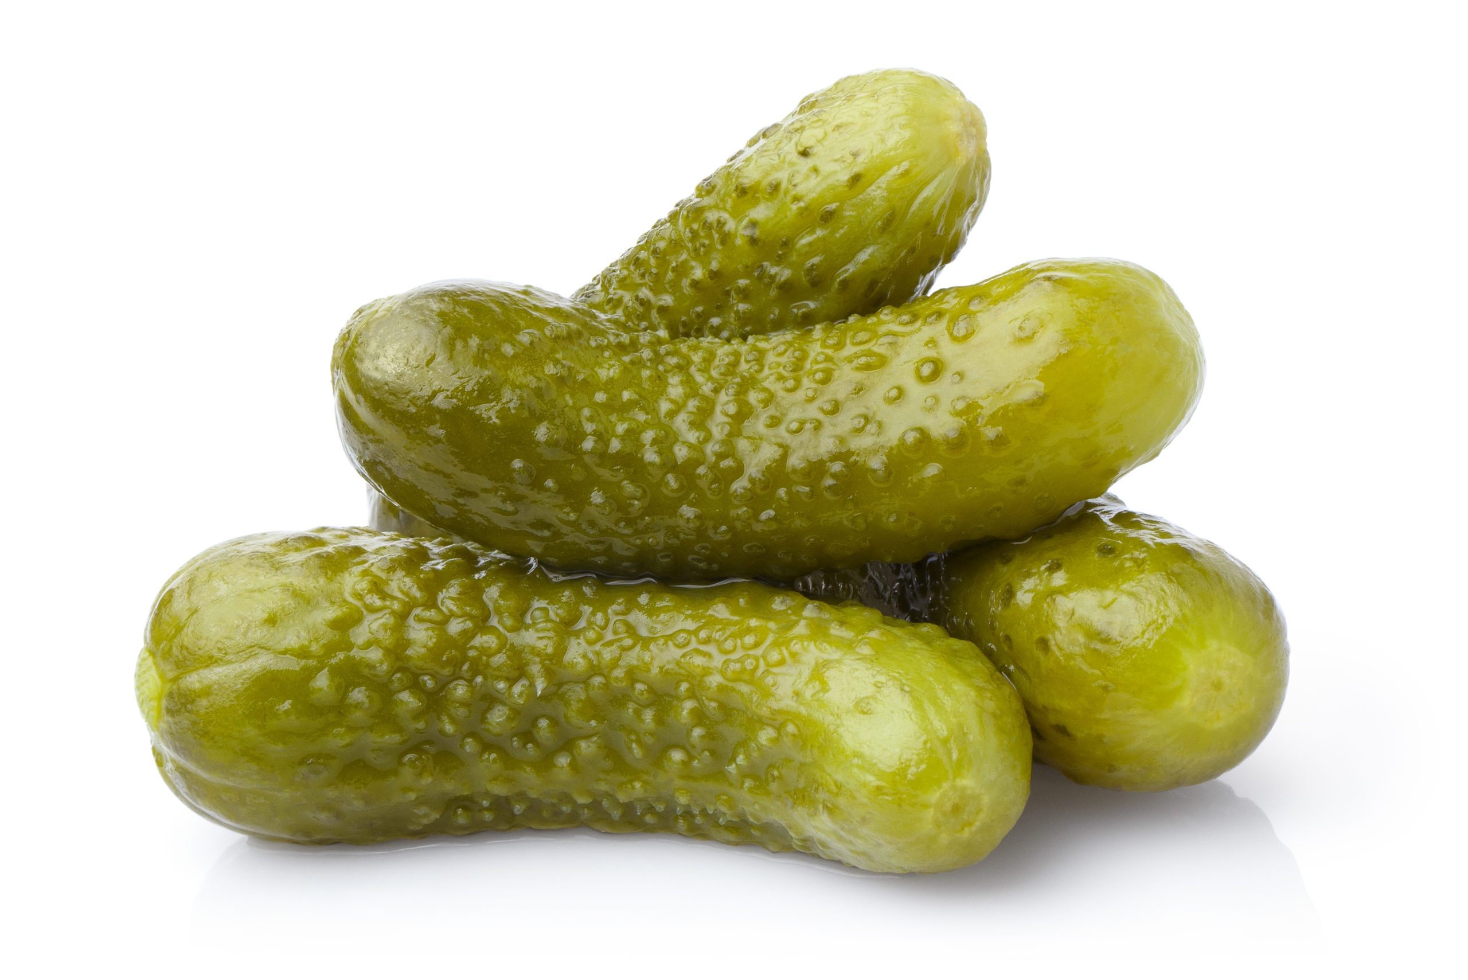
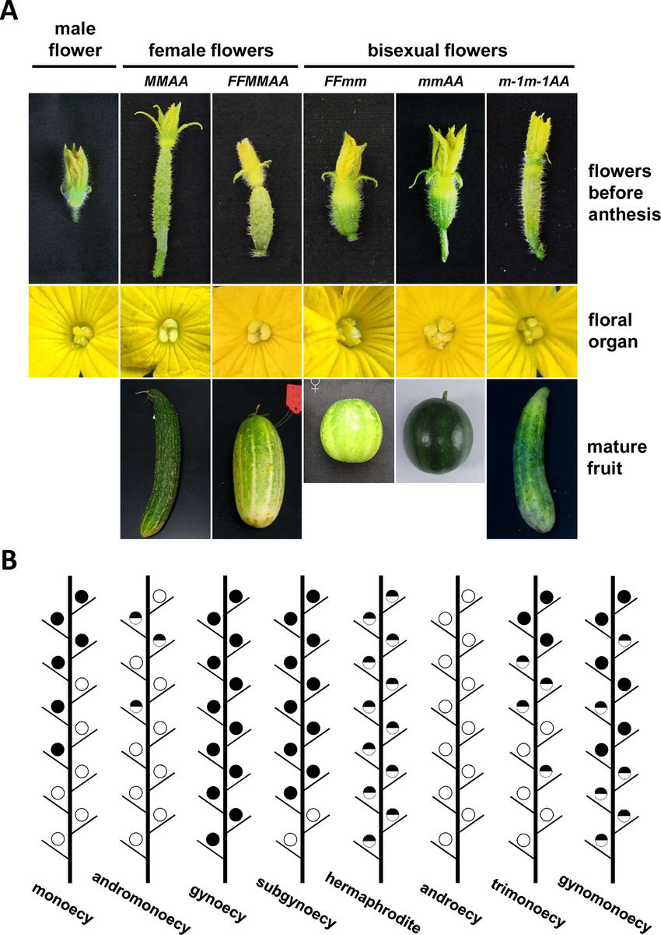
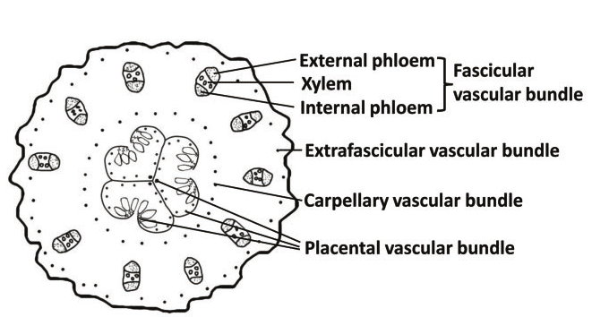
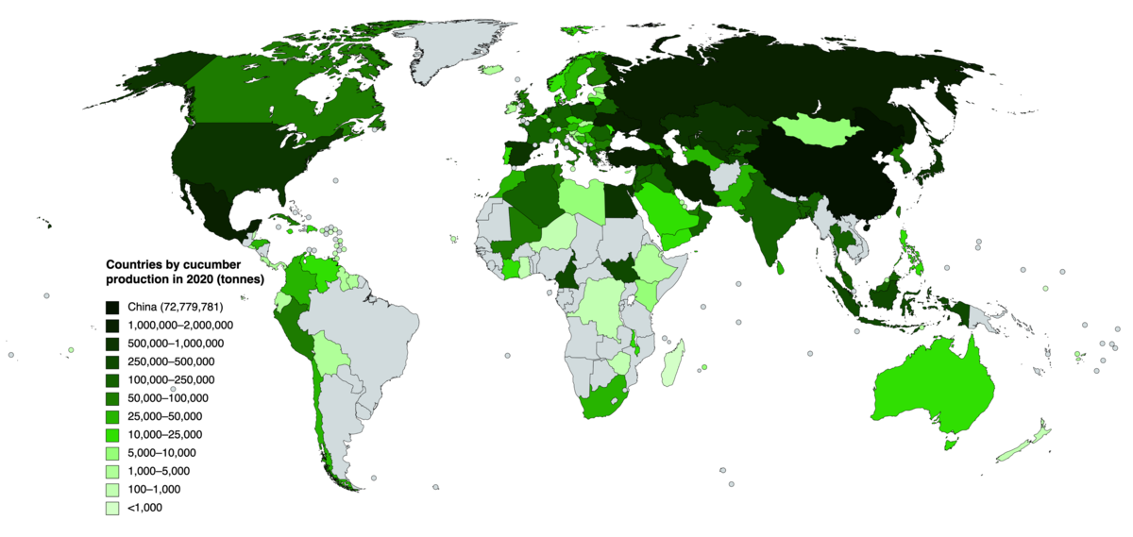
Studied Species: Cucumber
Model plant for sex determination and vascular biology studies
Important vegetable crop worldwide
Jianyu Zhao et.al, 2015,Plant and Cell Physiology
Pictures from Google
Dandan Li et.al, 2015, Frontiers in Plant Science

Slide 4
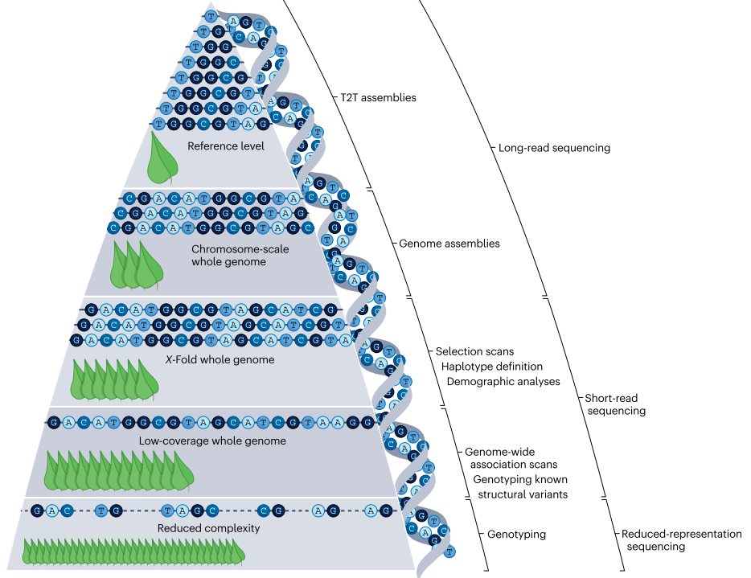
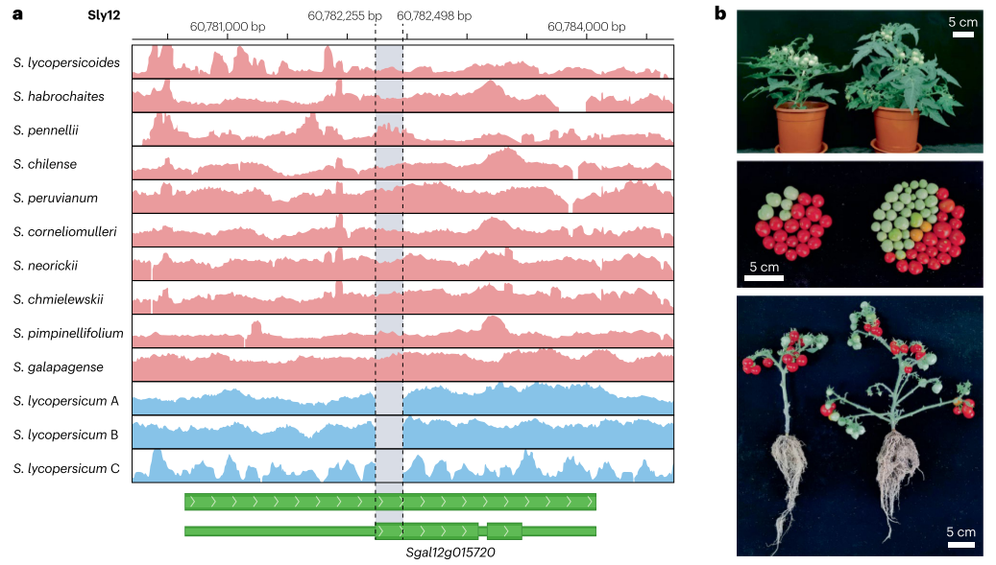
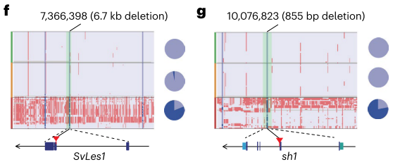
﻿Applications of pangenomes in crop plants
Li, N. et.al. Nat Genet 2023;55:﻿852-860
﻿Steve S. Ho. et.al. Nature Reviews Genetics 2024
He, Q. et.al. Nat Genet 2023;55:﻿1232-1242

Slide 5
Research question and goal
Construct a gene-based pan-genome and identify core and pan genes of different cucumber species
Identify candidate genes associated with traits such as stress resistance, nutritional enhancement, and yield increment through PAV (presence/absence variation) analysis during domestication
These findings will deepen our understanding of cucumber genetics, provide valuable resources for future cucumber breeding

Slide 6
Procedure
Orthogroup Identification
Protein Sequence
Gene Family
PAV Calculation
PAV Calculations
Pan-Core Identification
Selection Analysis
Identification of genes with significantly different occurrence frequency between wild, landrace, and cultivated accessions
PAV matrix
Enrichment Analysis
Genes with significantly different occurrence frequency between wild, landrace, and cultivated accessions
Enrichment

Slide 7
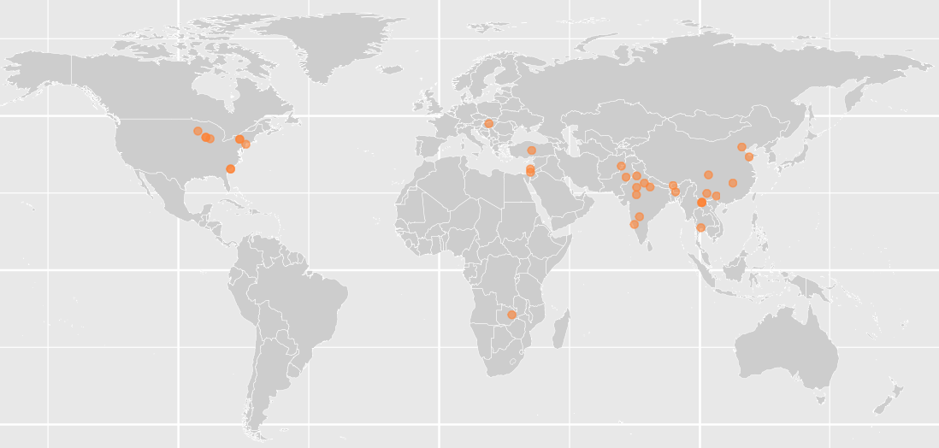
Materials
Taxa | Line name | Taxonomy | Gene number | Breeding status
AM001 | WI 2757 | Cucumis sativus var. sativus | 21756 | Cultivar
AM002 | WI7012 | Cucumis sativus var. sativus | 21754 | Cultivar
AM003 | WI7037 | Cucumis sativus var. sativus | 22007 | Cultivar
AM006 | NSL 106620 | Cucumis sativus var. sativus | 21771 | Cultivar
AM011 | WI7150 | Cucumis sativus var. sativus | 21949 | Cultivar
AM014 | WI7167 | Cucumis sativus var. sativus | 21889 | Landrace
AM015 | WI7204 | Cucumis sativus var. sativus | 21927 | Cultivar
AM016 | Poinsett 76 | Cucumis sativus var. sativus | 21525 | Cultivar
AM027 | PI 561148 | Cucumis sativus var. sativus | 21451 | Cultivar
AM061 | PI 179678 | Cucumis sativus var. hardwickii | 21704 | WIld
AM070 | PI 197088 | Cucumis sativus var. sativus | 21670 | Landrace
AM078 | PI 197088 | Cucumis sativus var. hardwickii | 22030 | WIld
AM084 | PI 249561 | Cucumis sativus var. sativus | 21755 | Landrace
AM125 | PI 330628 | Cucumis sativus var. sativus | 21538 | Landrace
AM288 | WI 5551 | Cucumis sativus var. hardwickii | 22361 | Cultivar
AM303 | WI7180 | Cucumis sativus var. sativus | 21683 | Landrace
AM306 | PI 109483 | Cucumis sativus var. sativus | 21927 | Cultivar
AM346 | PI 214155 | Cucumis sativus var. hardwickii | 21347 | Wild
AM353 | PI 462369 | Cucumis sativus var. hardwickii | 21812 | Wild
AM393 | WI7439 | Cucumis sativus var. sativus | 22243 | Cultivar
AM523 | WI 7724 | Cucumis sativus var. sativus | 21759 | Cultivar
AM568 | W I7646 | Cucumis sativus var. sativus | 21471 | Cultivar
AM716 | WI 7633 | Cucumis sativus var. sativus | 21899 | Cultivar
AM717 | PI 531313 | Cucumis sativus var. hardwickii | 21824 | Wild
AM718 | WI 7651 | Cucumis sativus var. sativus | 21906 | Landrace
AM739 | WI 7698 | Cucumis sativus var. sativus | 21784 | Landrace
AM746 | WI7773 | Cucumis sativus var. sativus | 21674 | Cultivar
NC001 | PI 618917 | Cucumis sativus var. sativus | 22126 | Cultivar
NC002 | Cu2 | Cucumis sativus var. sativus | 22091 | Cultivar
NC004 | PI 462369 | Cucumis sativus var. hardwickii | 22288 | Wild
NC008 | PI 214155 | Cucumis sativus var. hardwickii | 22176 | Wild
NC010 | 9110gt | Cucumis sativus var. sativus | 22042 | Cultivar
NC014 | CG6663 | Cucumis sativus var. sativus | 22107 | Cultivar
NC015 | PI 500361 | Cucumis sativus var. hardwickii | 21848 | Wild
NC030 | WI 9930 | Cucumis sativus var. sativus | 22207 | Cultivar
NC037 | PI 221440 | Cucumis sativus var. sativus | 21948 | Cultivar
NC064 | PI 183967 | Cucumis sativus var. hardwickii | 21643 | Wild
NC080 | CG9192 | Cucumis sativus var. sativus | 22005 | Landrace
NC117 | PI 175120 | Cucumis sativus vae. hardwickii | 22551 | Wild
39 assembled genomes from 10 countries covering different breeding status and phenotypes
Wild (10), Landrace (8), Cultivar (21)

Slide 8
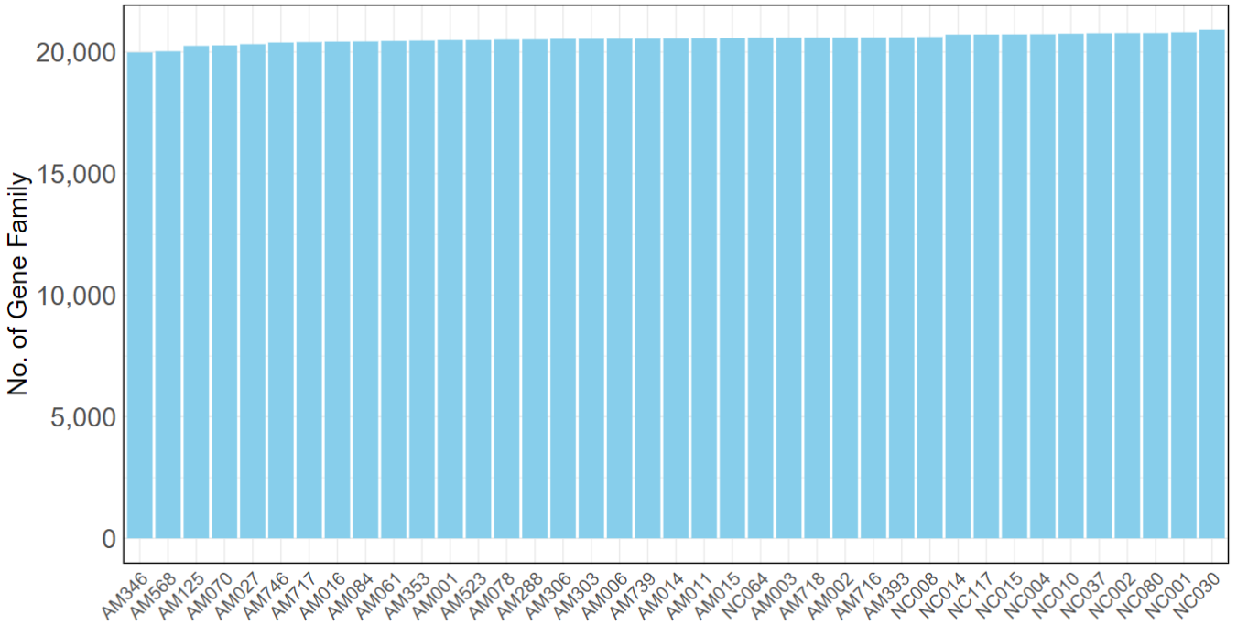
Orthogroup Identification
Protein Sequence of 39 cucumber species
Orthofinder
Gene Family
Gene Number for each assembled cucumber accession
Highest: 21,132 genes
Mean: 20,820 genes Lowest: 20,154 genes

Slide 9
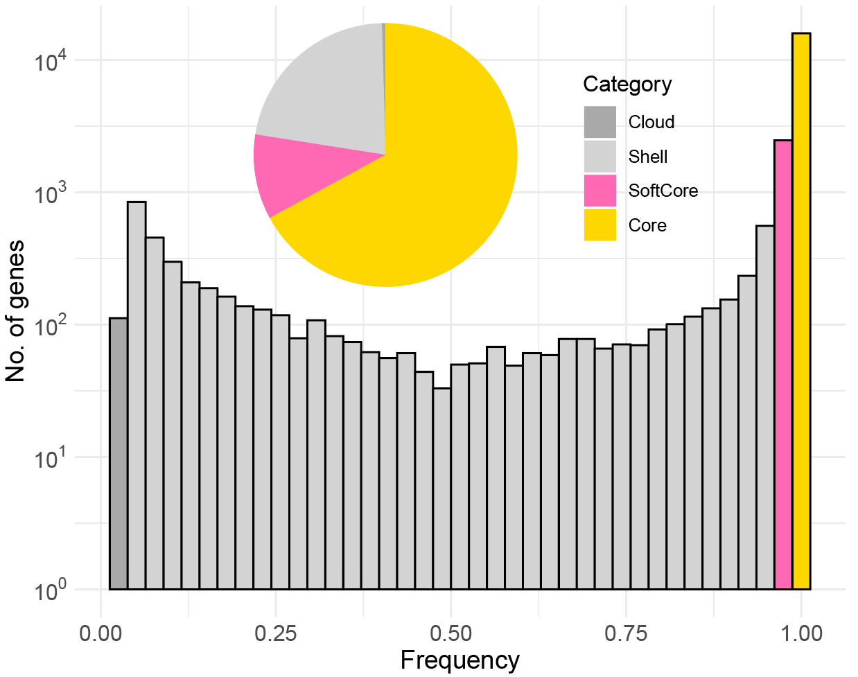
PAV Calculation
0.47%
Core: 100% SorftCore: 95% ~ 100% Shell: 5% ~ 99% Cloud: < 5%
Core: 15,924 SorftCore: 2,474 Shell: 5,235
Cloud: 112
22.05%
10.42%
67.06%
Identified 15,924 core-genes, 2,474 soft-core genes, 5,235 shell genes and 112 Cloud-genes in cucumber gene-based pangenome

Slide 10
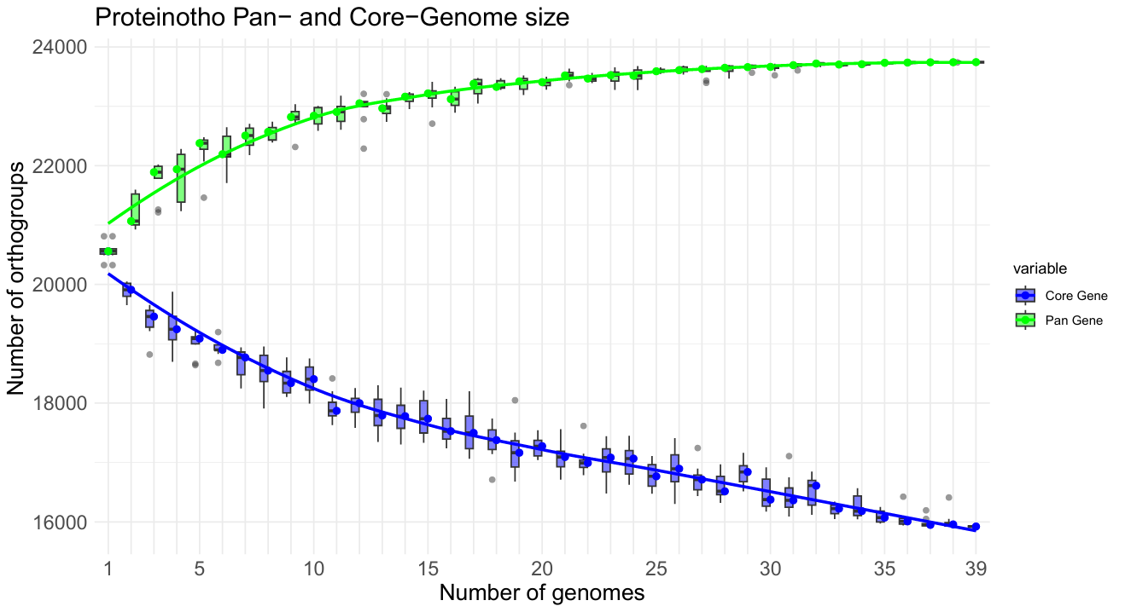
Characterization of the cucumber pan-genome
The curve of Pan- and Core- orthogroups with
respect to increment of genomes
Orthogroup number stables around 25 genomes (23,800 gene families), suggests this pan-genome captures sufficient genetic diversity in cucumber

Slide 11

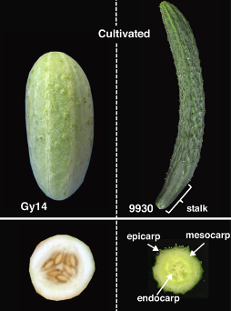
Selection Analysis
,
Agricultural categories | No. of gene with high present frequency
Wild vs.Landrace | 3,451
Landrace vs. Cultivated | 2,895
Through PAV calculation, identified 3451 genes with high present frequency Wild vs. Landrace and 2895 genes in Lanrace vs.Cultivated
Gen Che, Xiaolan Zhang, Elsevier, 2018

Slide 12
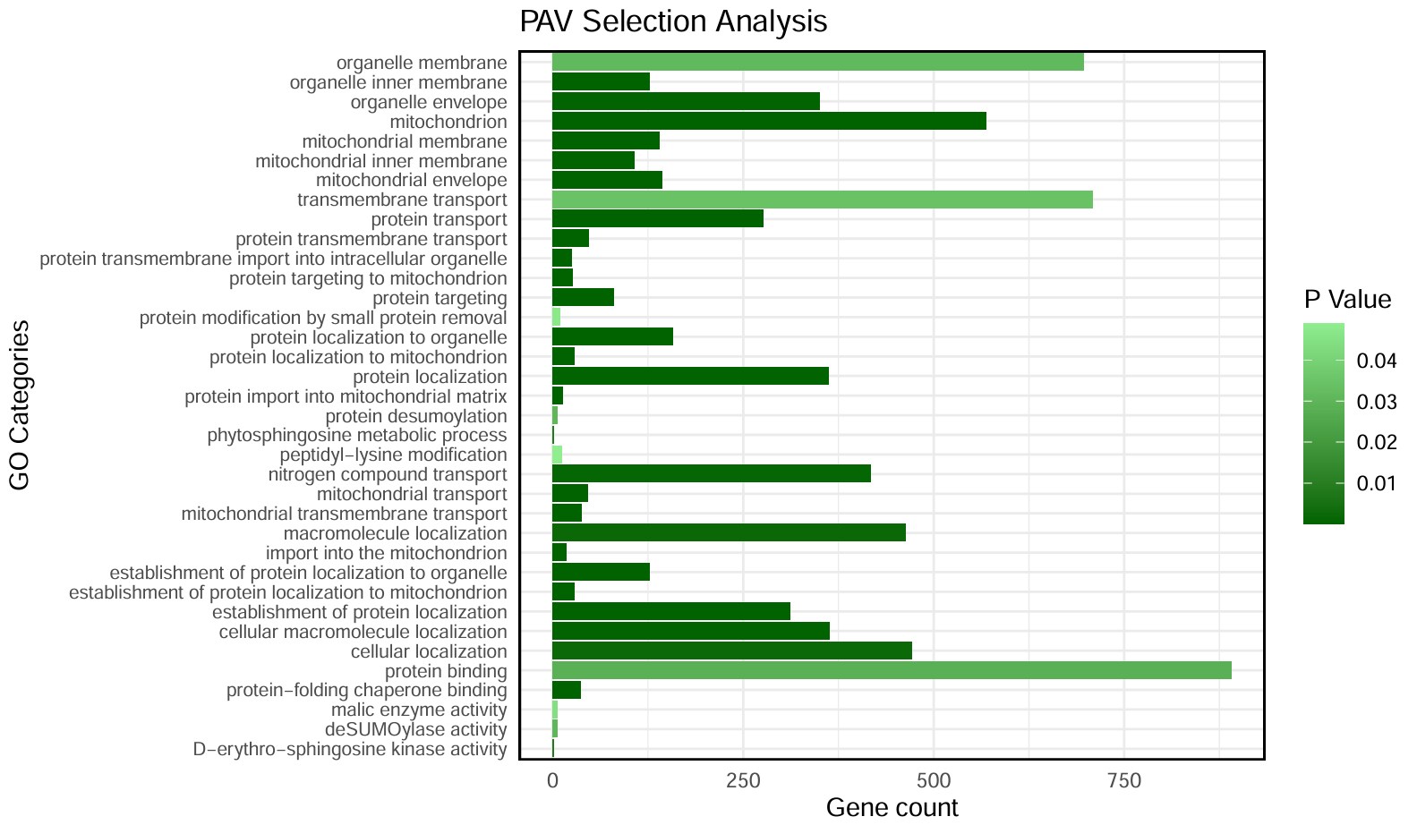
Enrichment Analysis
Identified genes with significantly different occurrence frequency between wild and cultivated accessions
Enrichment
Cucumber species exhibit significant gene enrichment in mitochondrial functions and protein transport, indicating essential roles in energy production and cellular organization.

Slide 13
Summary
Constructed gene-based pangenome of 39 cucumber genomes.
Identified 15,924 core-genes, 2,474 soft-core genes, 5,235 shell genes and 112 Cloud-genes in cucumber gene-based pangenome.
Through PAV calculation, identified 2193 genes with high present frequency in wild vs cultivated cucumber species, enriched in mitochondrial functions and protein transport.
This project provided resource for cucumber pangenome studies, identified genes with different PAV in wild vs domesticated species, and provided value in future cucumber breeding.

Slide 14
Thank You

